Slide 1
Tomato Quality Prediction with CNN Model
Team Members:
Venkata Sai VamsiKrishna Manuri
Sonu Kanna

Slide 2
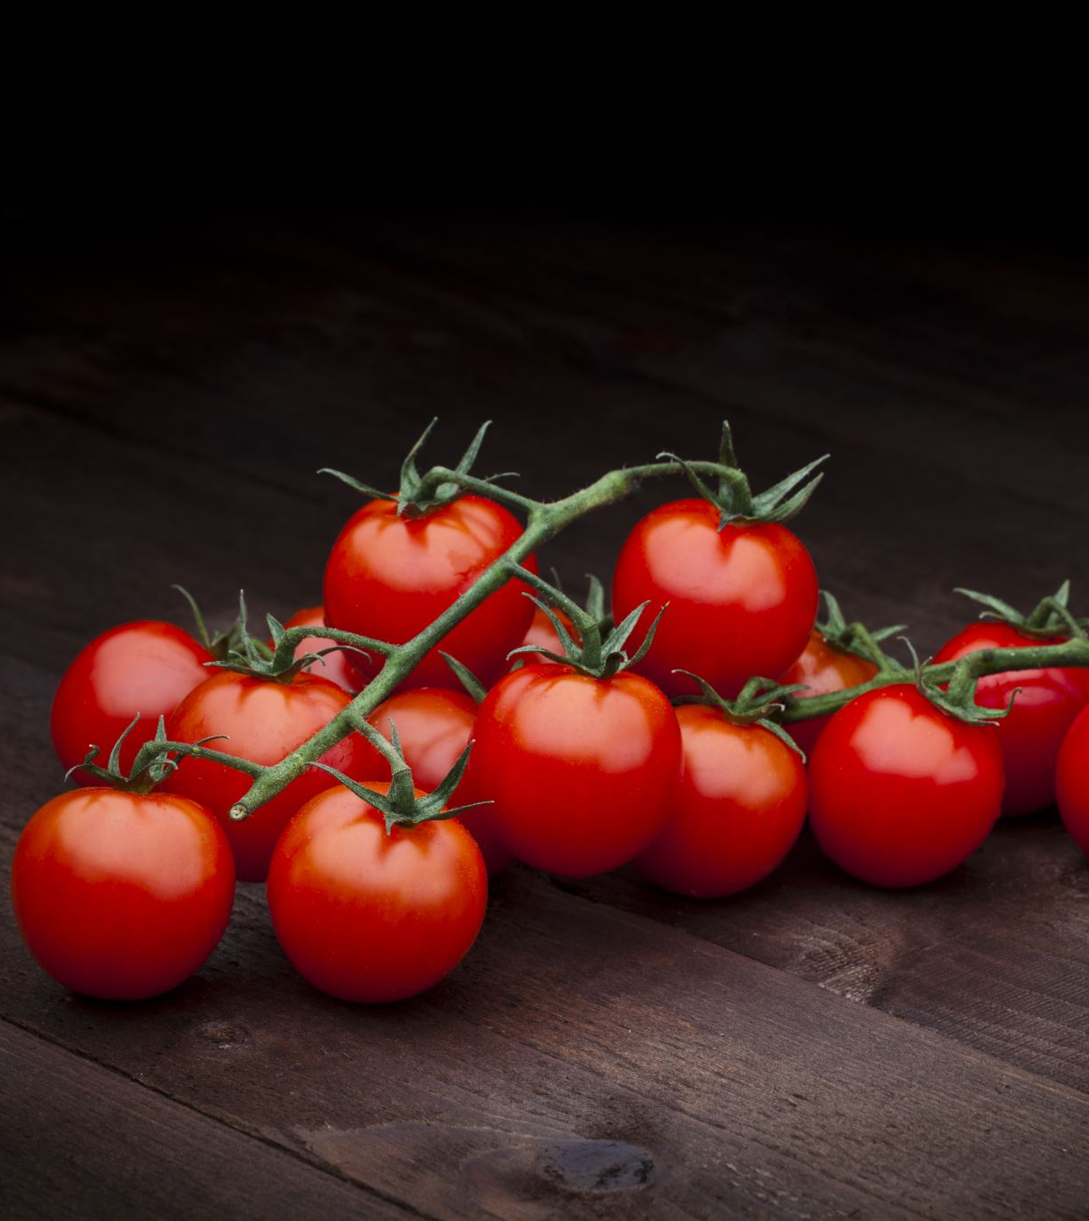
Introduction
Problem Statement:
Tomatoes are susceptible to diseases and pests, leading to crop losses.
Manual inspections are subjective, time-consuming, and error-prone.
Our Recommended Solution:
Use Convolutional Neural Networks (CNNs) to automate tomato quality prediction.

Slide 3
Dataset Description
Source:
Images from Sher-e-Bangla Agricultural University.
Classes:
"Fresh" and "Rotten".
Preprocessing:
Augmentation techniques: rotation, zoom, flipping, scaling.
Image resizing, normalization, and dataset split.

Slide 4
Model Selection
Why CNN?:
CNNs excel at image classification.
Automatic feature extraction.
Model Architecture:
Convolutional layers, max-pooling, dense layers, dropout.
Adam optimizer, binary cross-entropy loss.
Expected Output:
Classification into "Fresh" or "Rotten".

Slide 5
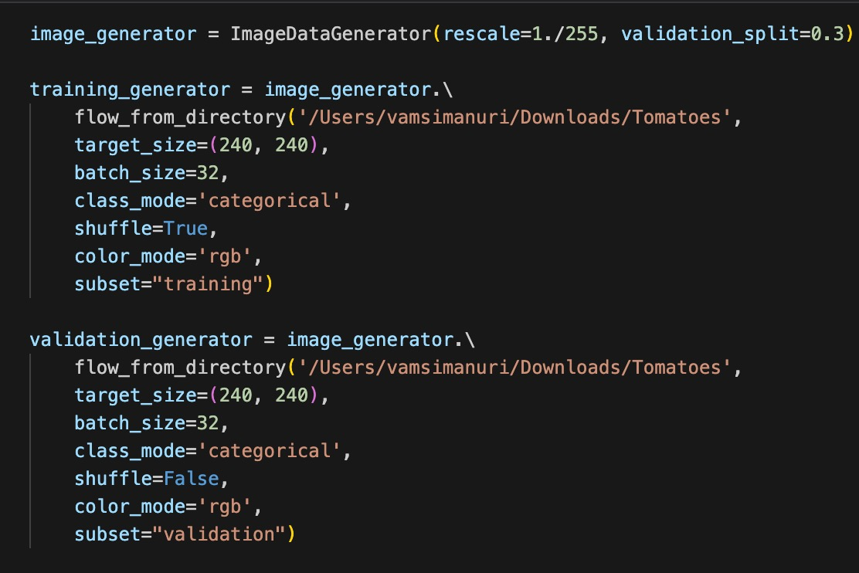
Data Preparation

Slide 6
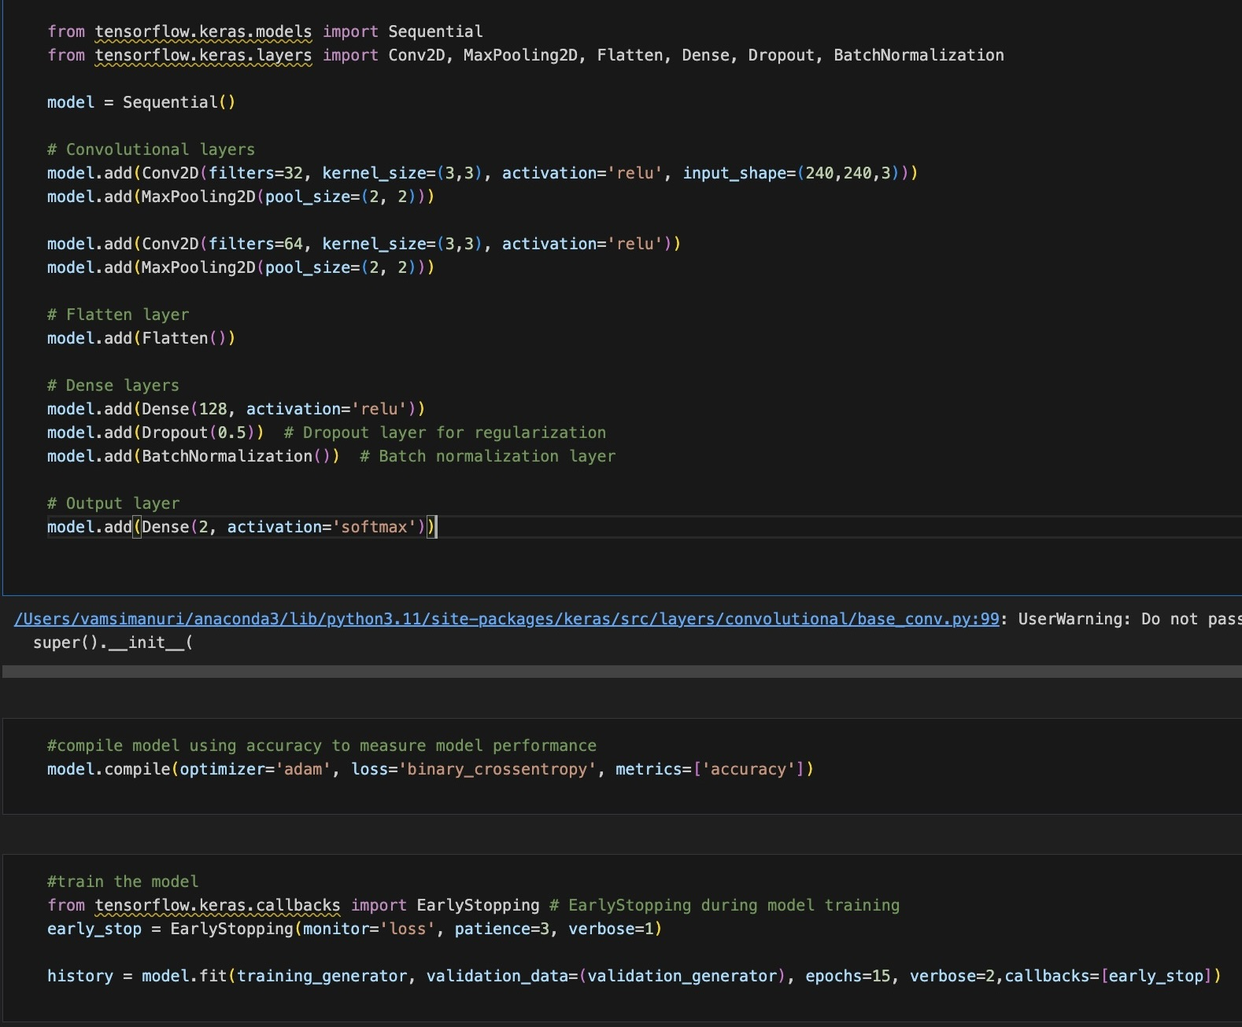
Built CNN Model

Slide 7
Model Accuracy and Loss

Slide 8
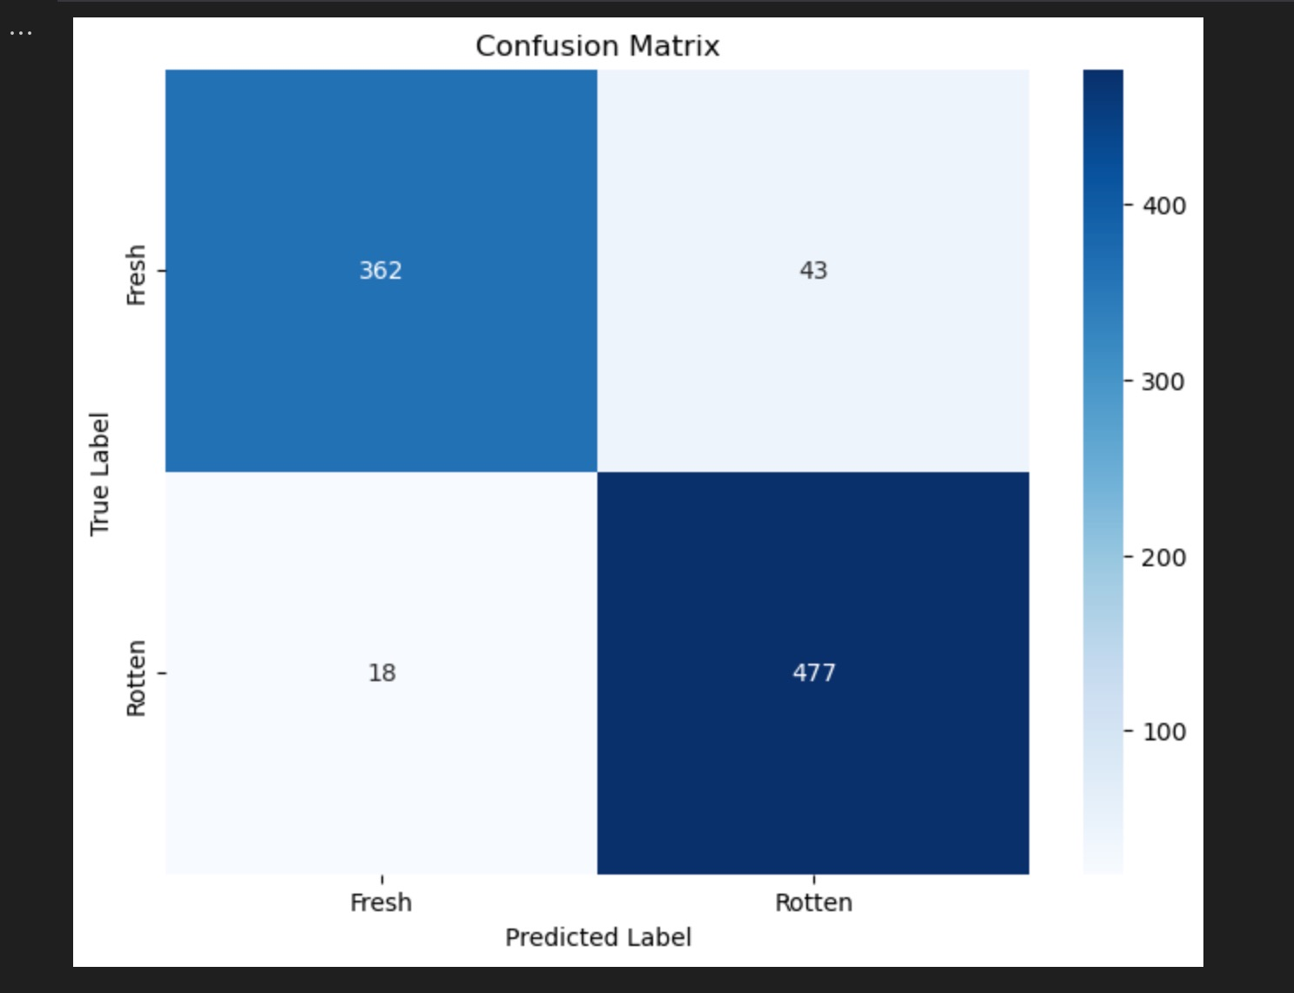
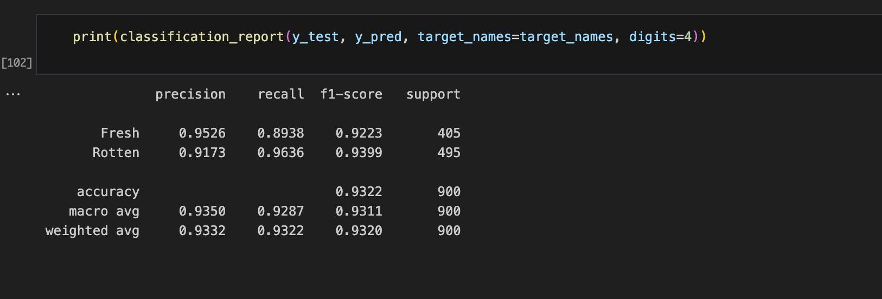
Evaluation Metric

Slide 9
Model Performance Metrics
Precision:
For the "Fresh" class: Precision is 95.26%. This means that among all tomatoes predicted as "Fresh" by the model, 95.26% were actually "Fresh."
For the "Rotten" class: Precision is 91.73%. This indicates that among all tomatoes predicted as "Rotten" by the model, 91.73% were actually "Rotten."

Slide 10
Model Performance Metrics
Recall::
For the "Fresh" class: Recall is 89.38%. This means that out of all actual "Fresh" tomatoes, the model correctly identified 89.38% of them as "Fresh." For the "Rotten" class: Recall is 96.36%. This indicates that out of all actual "Rotten" tomatoes, the model correctly identified 96.36% of them as "Rotten."

Slide 11
Model Performance Metrics
F1-score:
For the "Fresh" class: F1-score is 92.23%. The F1-score is the harmonic mean of precision and recall. It provides a single metric that balances both precision and recall. For the "Rotten" class: F1-score is 93.99%.

Slide 12
Model Performance Metrics
Accuracy:
Overall accuracy of the model is 93.22%. This indicates the proportion of correctly classified samples out of the total number of samples.

Slide 13
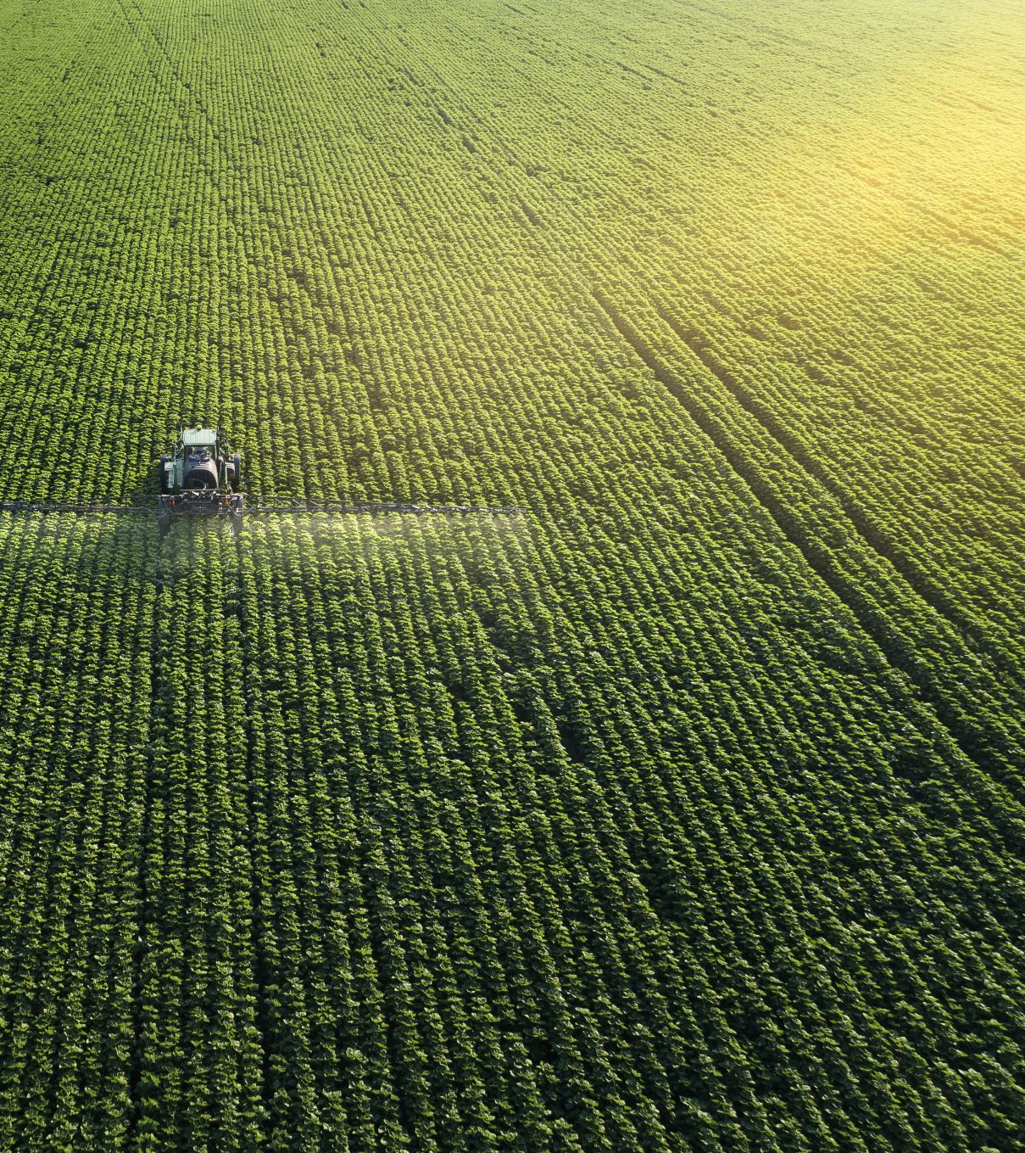
Research Reflection
Application Potential:
Enables early detection of diseases, allowing farmers to take corrective measures to protect their crops.
Future Vision:
Integration with farm management software to provide real-time data analytics and trend analysis.
Impact:
Reduces reliance on manual labor, lowering costs and promoting a data-driven approach to farming.

Slide 14

Challenges and Limitations
Technical Challenges:
Data cleaning, model tuning, and overfitting risks.
Operational Limitations:
Cost of deployment, environmental factors.

Slide 15
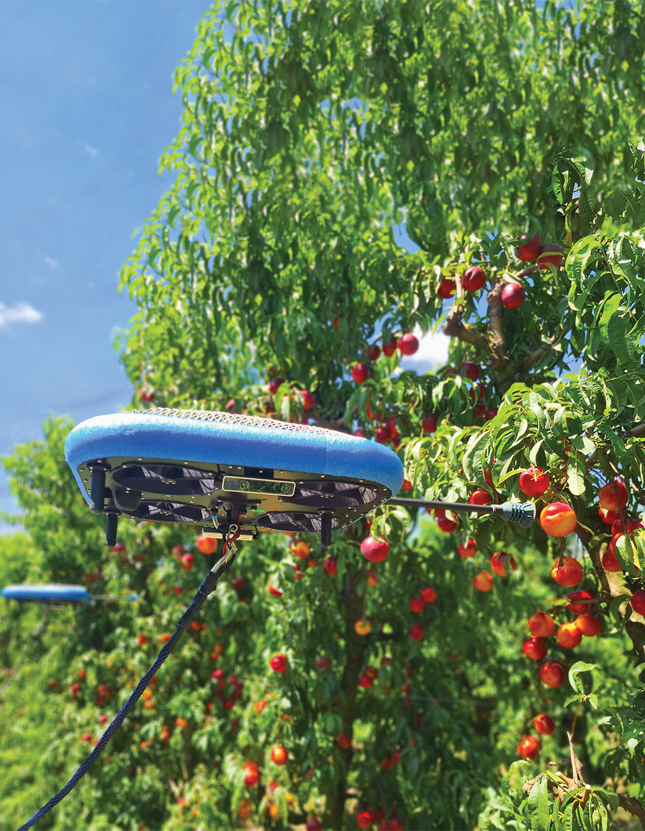
Conclusion
Next Steps:
Additional model testing and validation.
Explore deployment options, including drones.
Conclusion:
Reiterate the benefits of using CNN for tomato quality prediction.
Express enthusiasm for the project's future applications.

